Slide 1
COMP 76 – User Flows & Wireframes
Fall 2023 – Week 5

Slide 2
AGENDA
Questions
Recap
Competitive Audit II
User Flows

Slide 3
Recap
Empathy
What are the users experiencing
Personas
Who are we empathizing with?
User Stories
What are they trying to do, specifically
User Journey
What steps do they take to accomplish their goal
Ideation
Narrow down the problem, think about solutions

Slide 4
Competitive Audit II
An Example

Slide 5

Competitive audit
Strengths:
Don’t sell just coffee
Nice atmosphere
Prices
Local products
High rating
Location
Catering
Weaknesses:
No About
Navigation website
Childish logo
No drive-thru
Amount of food
Open hours

Slide 6

Competitive Audit
Strengths:
Reputation
Variety
Locations
Culture
Convenient app
Atmosphere
Reward system
Weaknesses:
Price
Always getting my name wrong
Sizes
Speed
Always a line
Open hours

Slide 7

Competitive audit
Wide variety
Fast service
Extend open hours
Cup sizes simple name
Local products
Create a culture
Adding drive-thru
Student discount
Packaging
Eco-friendly
Merchandise
App/website design
Charity driven money pool
Community pull
Rewards

Slide 8
User Journey vs User Flow
What’s going on here!?!??!?!

Slide 9
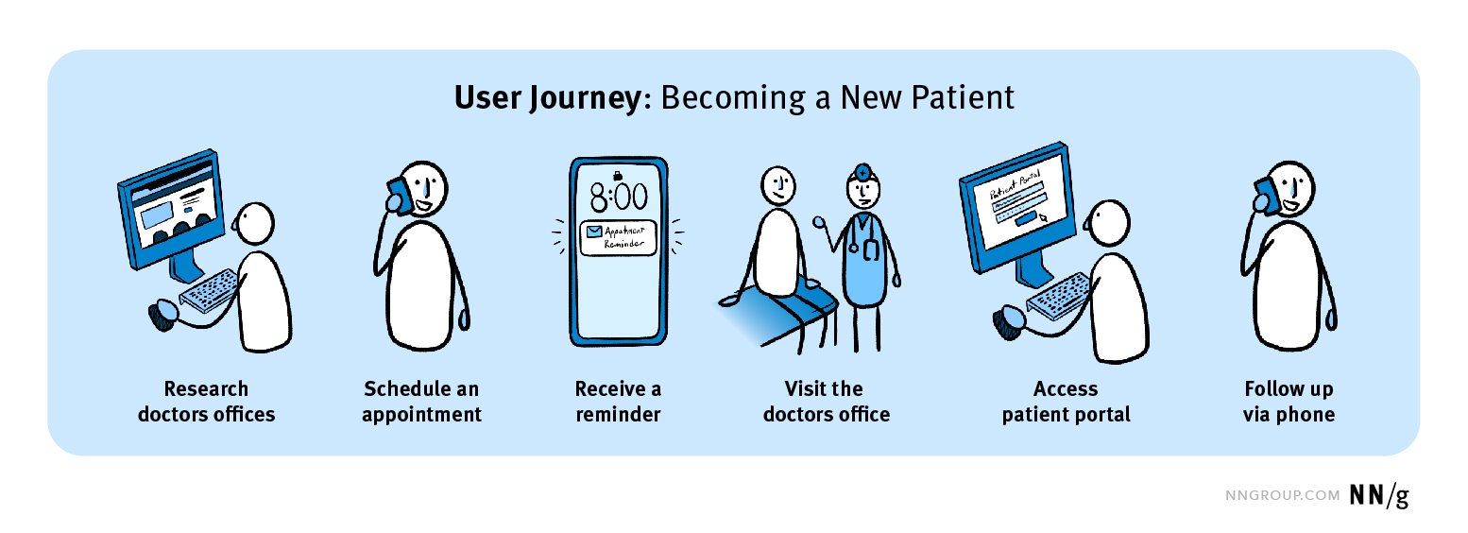
User Journey (Recap)
A user journey is the high-level series of experiences a user has as they interact with your product to accomplish a goal

Slide 10
SPOILER
User Journey
A user journey is the high-level series of experiences a user has as they interact with your product to accomplish a goal
User Flow
The specific path and interactions taken during the journey

Slide 11
User Flows

Slide 12
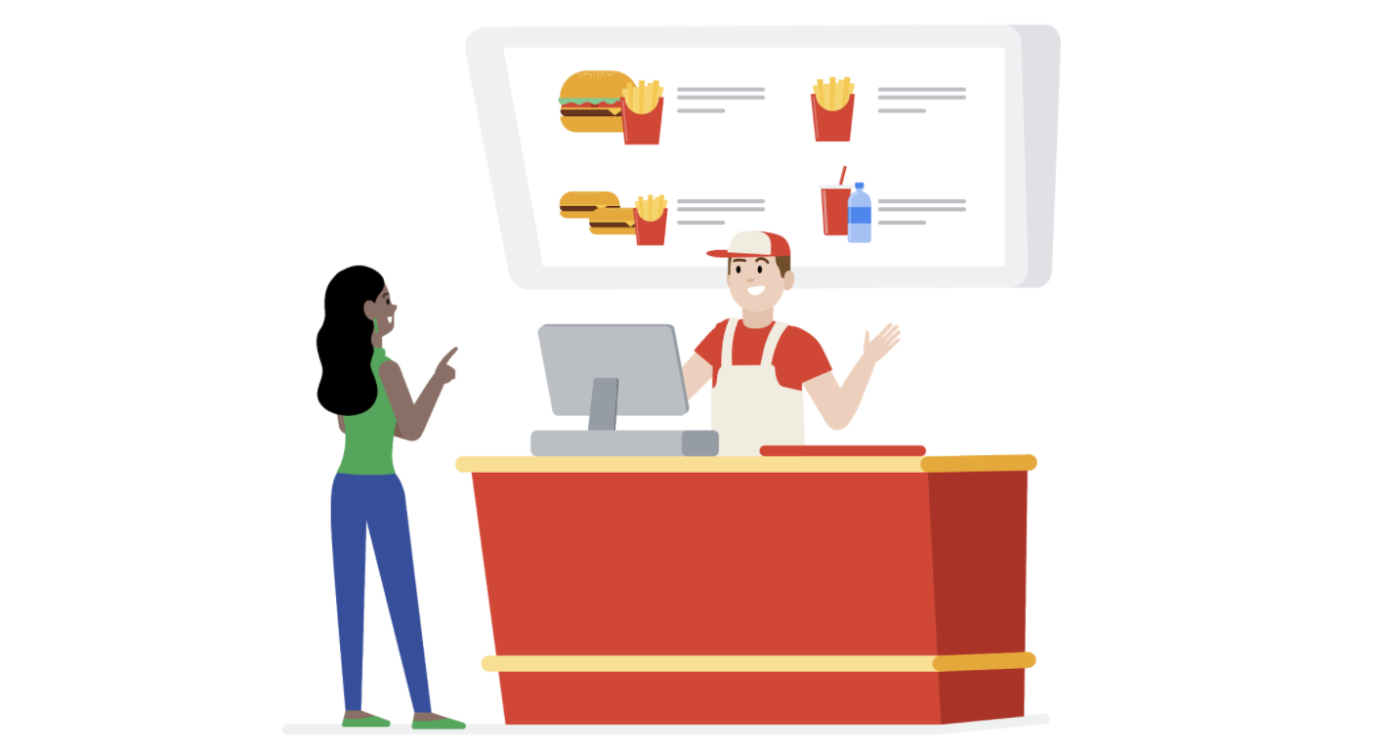
User Flow
The specific path taken by a typical user on an app or website, so they can complete a task from start to finish.

Slide 13
Flows?
QUESTION: Can there be more than one flow for a user journey?

Slide 14
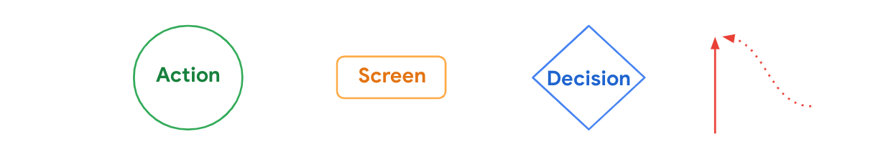
Draw a user flow
System Action
User Input

Slide 15
Actions
Screen
The actions users take when moving through a product design are represented as circles. In other words, circles show steps that must be taken to complete a task from start to finish. For the user flow of a dog walker app, actions might include opening the app, clicking on a dog walker’s profile, and booking a dog walker.
The screens of a digital product that users will experience while completing tasks are represented as rectangles. For the user flow of a dog walker app, screens might include a homepage or a booking confirmation page.

Slide 16
User flow direction
Decision
Diamonds represent points in the user flow where users must ask a question and make a decision. The decision users make will either move them forward through the flow or back to an earlier part of the flow. For the user flow of a dog walker app, a decision could be choosing whether or not to book the dog walker whose profile is being reviewed.
Lines with arrows tie everything together and display the flow of information. Solid lines indicate forward direction through the user flow, and the dotted lines indicate backward direction or returning to a previous page.

Slide 17
System Action
Data Input
A dotted or broken line circle represents a differentiation from user actions. A system action is something the system will need to do as a result of a user action, for example calculate age after user inputs their birthdate.
This shape represents points where we require users to input data, for example by completing a form.
System Action
User Input

Slide 18
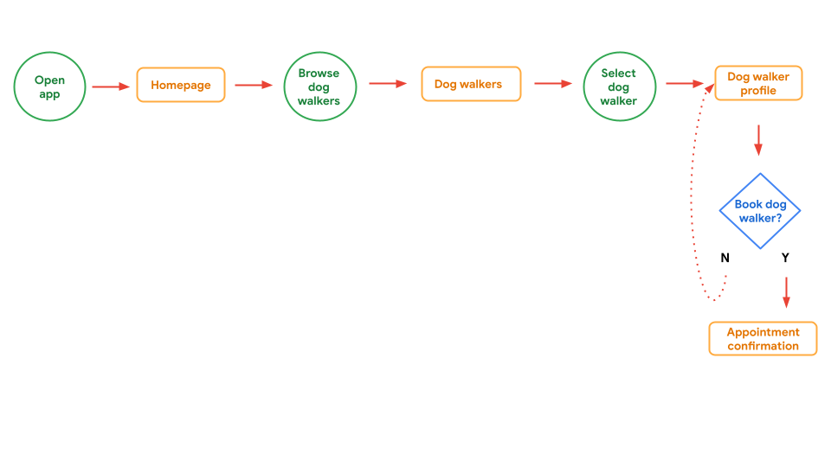
Example of a user flow

Slide 19
Make a User Flow

Slide 20

Draw a user flow
CoffeeHouse App
Screen
Here is an example of user flow steps from entry point to task completion for the CoffeeHouse app:
Open app
Home screen
Search coffee locations
Select coffee location
Order from here? Yes or No
Order screen
Click link to share coffee menu
Send menu to team? Yes or No
Start order timer
Team adds items to order
Order preview
Go to checkout
Insert checkout information
Confirm order? Yes or No
Order confirmation
Action
Decision
User Input
System Action

Slide 21
Wireframes
Let’s make some boxes

Slide 22
Wireframes…Getting Started
Also referred to as Low-Fidelity prototyping
Start simple
Low Cost of Execution!
Paper Prototypes
No details, just boxes and lines
Even with a refined product, start here
This is the first step in our progression

Slide 23
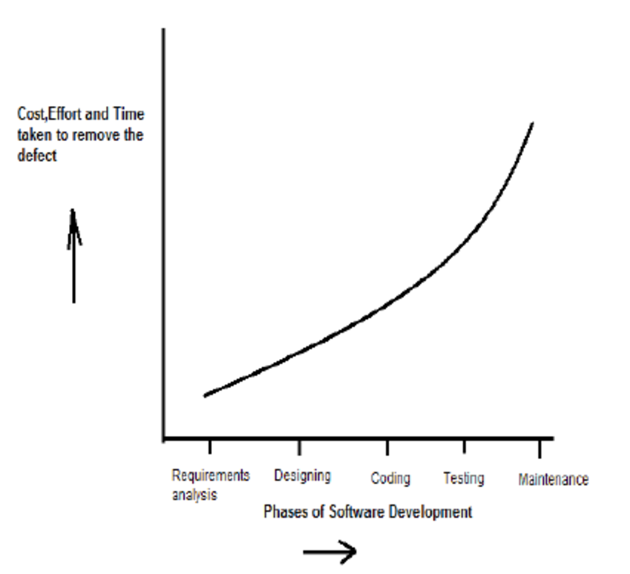
Wireframes…The Progression
COST OF EXECUTION
Paper Prototype
Low Fidelity Prototype
Medium Fidelity Prototype
High Fidelity Prototype

Slide 24
Wireframes…The Paper Prototype
PROS
COST OF EXECUTION!!!
The changes are cheap, easy, and very, very flexible!
Keeps the user as the priority
CONS
Difficult to share
Hard to experience without LOTS of paper
Can be time consuming
Can be hard to truly visualize a digital product

Slide 25
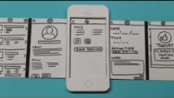
Paper Prototype Experience

Slide 26



From Paper to Digital
Easy to share
Faster than paper
More relatable experience
Lots of options

